Slide 1
Machine Learning

Slide 2
Major Topics to be covered
Decision Theory
Bayesian Decision Theory
Classification Models
Clustering (segmenting data into classes)
Feature Selection

Slide 3
Questions
Difference between Noise and Missing Values
Why we need pre-processing
What is post processing
What are databases
What are data warehousing
What is data mining
Why we need to reduce the dimensions of data….
Can feature extraction is random on need some approach.

Slide 4
Decision Theory and Factors
Decision Boundaries based on Decision Theories
Logical Limits
Evidences
Cost????? What type of cost
Pre-Processing……
Feature Extraction……. Dimension Reduction Approches
Noise
Overfitting
Missing Features
Read from Page 15 to onwards

Slide 5
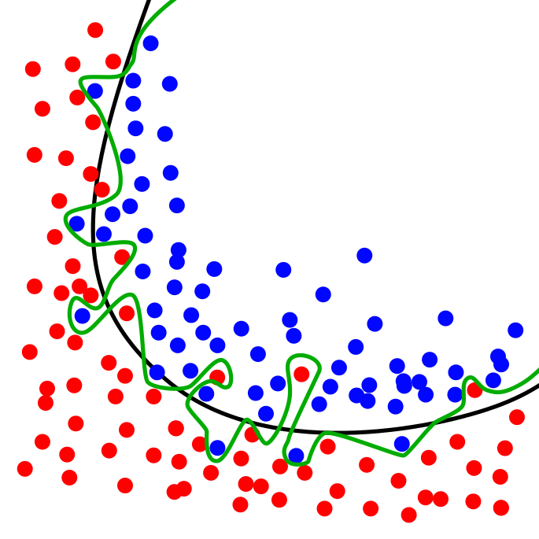
Example[Ref. Wikipedia]

Slide 6
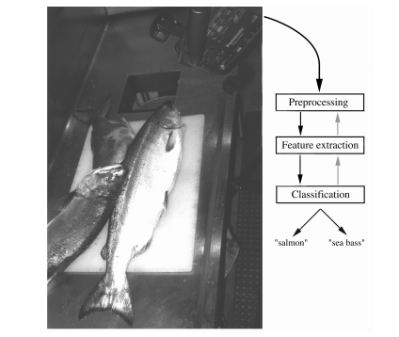
Example of Pattern Recognition Process
Objects to be classified are sensed by transducer (camera)
Signals are pre-processed
Features are extracted
Classification is performed

Slide 7
Knowledge Discovery
A KDD process includes data cleaning, data integration, data selection, transformation, data mining, pattern evaluation, and knowledge presentation

Slide 8
KDD Process: A Typical View
Pattern
Information
Knowledge
Data Mining Approaches
Post-Processing
Input Data
Data Pre-Processing
Data integration
Normalization
Feature selection
Dimension reduction
Pattern discovery
Association & correlation
Classification
Clustering
… … … …
Pattern evaluation
Pattern selection
Pattern interpretation
Pattern visualization
This is a view from typical machine learning and statistics communities

Slide 9
Knowledge Discovery (KDD) Process
Knowledge
This is a view from typical database systems and data warehousing communities
Data mining plays an essential role in the knowledge discovery process
Pattern Evaluation
Data Mining
Task-relevant Data
Data Warehouse
Selection
Data Cleaning
Data Integration
Databases

Slide 10
Process (1): Model Construction
Classification
Algorithms
Training
Data
Classifier
(Model)
IF rank = ‘professor’
OR years > 6
THEN tenured = ‘yes’

Slide 11
Process (2): Using the Model in Prediction
Classifier
Testing
Data
Unseen Data
(Jeff, Professor, 4)
Tenured?

Slide 12
Type of Approaches for Analysis
Supervised Approaches
Unsupervised Approaches
Semi Supervised Approaches

Slide 13
Supervised vs. Unsupervised Learning
Supervised learning (classification)
Supervision: The training data (observations, measurements, etc.) are accompanied by labels indicating the class of the observations
New data is classified based on the training set
Unsupervised learning (clustering)
The class labels of training data is unknown
Given a set of measurements, observations, etc. with the aim of establishing the existence of classes or clusters in the data

Slide 14
Prediction Problems: Classification vs. Numeric Prediction
Classification
predicts categorical class labels (discrete or nominal)
classifies data (constructs a model) based on the training set and the values (class labels) in a classifying attribute and uses it in classifying new data
Numeric Prediction
models continuous-valued functions, i.e., predicts unknown or missing values
Typical applications
Credit/loan approval:
Medical diagnosis: if a tumor is cancerous or benign
Fraud detection: if a transaction is fraudulent
Web page categorization: which category it is

Slide 15
Classification—A Two-Step Process
Model construction: describing a set of predetermined classes
Each tuple/sample is assumed to belong to a predefined class, as determined by the class label attribute
The set of tuples used for model construction is training set
The model is represented as classification rules, decision trees, or mathematical formulae
Model usage: for classifying future or unknown objects
Estimate accuracy of the model
The known label of test sample is compared with the classified result from the model
Accuracy rate is the percentage of test set samples that are correctly classified by the model
Test set is independent of training set (otherwise overfitting)
If the accuracy is acceptable, use the model to classify new data
Note: If the test set is used to select models, it is called validation (test) set
Confusion Matrix…..

Slide 16
Types of Data Sets
Record
Relational records
Data matrix, e.g., numerical matrix
Document data: text documents: term-frequency vector
Transaction data
Graph and network
World Wide Web
Social or information networks
Molecular Structures
Ordered
Video data: sequence of images
Temporal data: time-series
Sequential Data: transaction sequences
Genetic sequence data
Spatial, image and multimedia:
Spatial data: maps
Image data:
Video data:

Slide 17
Important Characteristics of Structured Data
Dimensionality
Curse of dimensionality
Sparsity
Only presence counts
Resolution
Patterns depend on the scale
Distribution
Centrality and dispersion

Slide 18
Data Objects
Data sets are made up of data objects.
A data object represents an entity.
Examples:
sales database: customers, store items, sales
medical database: patients, treatments
university database: students, professors, courses
Also called samples , examples, instances, data points, objects, tuples.
Data objects are described by attributes.
Database rows -> data objects; columns ->attributes.

Slide 19
Attributes
Attribute (or dimensions, features, variables): a data field, representing a characteristic or feature of a data object.
E.g., customer _ID, name, address
Types:
Nominal
Binary
Numeric: quantitative

Slide 20
Attribute Types
Nominal: categories, states, or “names of things”
Hair_color = {auburn, black, blond, brown, grey, red, white}
marital status, occupation, ID numbers, zip codes
Binary
Nominal attribute with only 2 states (0 and 1)
Symmetric binary: both outcomes equally important
e.g., gender
Asymmetric binary: outcomes not equally important.
e.g., medical test (positive vs. negative)
Convention: assign 1 to most important outcome (e.g., HIV positive)
Ordinal
Values have a meaningful order (ranking) but magnitude between successive values is not known.
Size = {small, medium, large}, grades, army rankings

Slide 21
Numeric Attribute Types
Quantity (integer or real-valued)
Interval
Measured on a scale of equal-sized units
Values have order
E.g., temperature in C˚or F˚, calendar dates
No true zero-point
Ratio
Inherent zero-point
We can speak of values as being an order of magnitude larger than the unit of measurement (10 K˚ is twice as high as 5 K˚).
e.g., temperature in Kelvin, length, counts, monetary quantities

Slide 22
Discrete vs. Continuous
If a variable can take on any value between two specified values, it is called a continuous variable;
otherwise, it is called a discrete variable.
Suppose the fire department mandates that all fire fighters must weigh between 150 and 250 pounds. The weight of a fire fighter would be an example of a continuous variable; since a fire fighter's weight could take on any value between 150 and 250 pounds.
Suppose we flip a coin and count the number of heads. The number of heads could be any integer value between 0 and plus infinity. However, it could not be any number between 0 and plus infinity. We could not, for example, get 2.5 heads. Therefore, the number of heads must be a discrete variable

Slide 23
Major Issues in ML
Mining Methodology
Mining various and new kinds of knowledge
Mining knowledge in multi-dimensional space
Boosting the power of discovery in a networked environment
Handling noise, uncertainty, and incompleteness of data
Pattern evaluation and pattern- or constraint-guided mining
User Interaction
Interactive mining
Incorporation of background knowledge
Presentation and visualization of data mining results

Slide 24
Major Issues in ML
Efficiency and Scalability
Efficiency and scalability of data mining algorithms
Parallel, distributed, stream, and incremental mining methods
Diversity of data types
Handling complex types of data
Mining dynamic, networked, and global data repositories
Data mining and society
Social impacts of data mining
Privacy-preserving data mining
Invisible data mining

